Slide 1

Ride with purpose. Lead with heart.
www.GFWC-OK.org www.GFWC.org

Slide 2
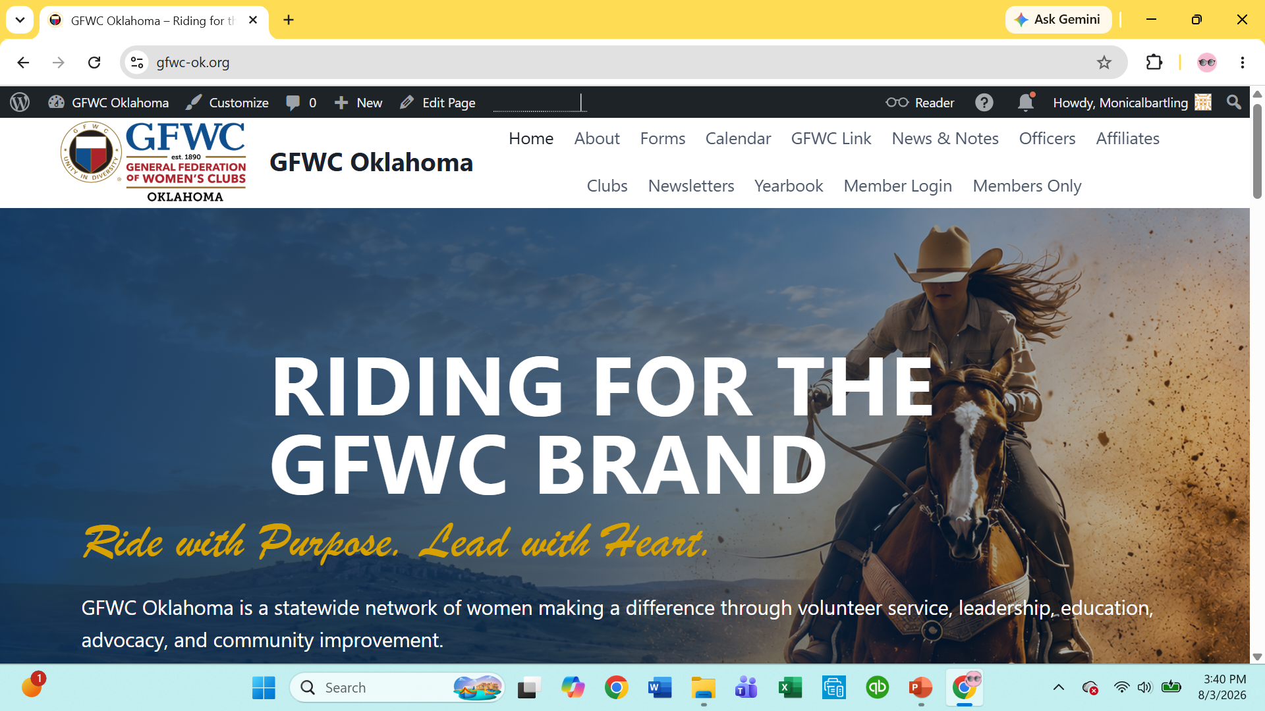


Summer Leadership Series
Every Monday in August – 7 p.m. to 8 p.m.
Super STAR Presenters
Week Three – Where to find and how to use the resources provided by GFWC and GFWC Oklahoma for your club programming. GFWC Digital Information Portal and signing up for the Political Action Center. How to use the GFWC Oklahoma website. Where to find newsletters, and reporting information for the 2026-2028 Club year. Presented by your GFWC Oklahoma Officer Team.
Week Four – Community Impact Award (CIP) How to’s presented by CIP Chairman, Linda F Babeuf, Chairman GFWC Middle Atlantic Region, and Past State President and Oklahoma CIP Chairman.
Week Five – Legislation and Public Policy presented by Past South Central Region President and SCR Committee Member, Marianne Maynard; Communication and Public Relations, presented by Val Redington, Past New Mexico State President and SCR Chairman. Two great presenters!

Slide 3
Tonight’s Line-up
Website tips and tricks – Monica Bartling, President, GFWC Oklahoma
  Members Only – joining and logging in
Minutes, not Memoirs – Brenda Calahan, Secretary, GFWC Oklahoma
Report writing to record history and win awards – Hon. Jacqueline Stout.
The Treasurer’s Report – Betty Clay, Treasurer, GFWC Oklahoma
Why join GFWC? -- Sharon Robinson

Slide 4
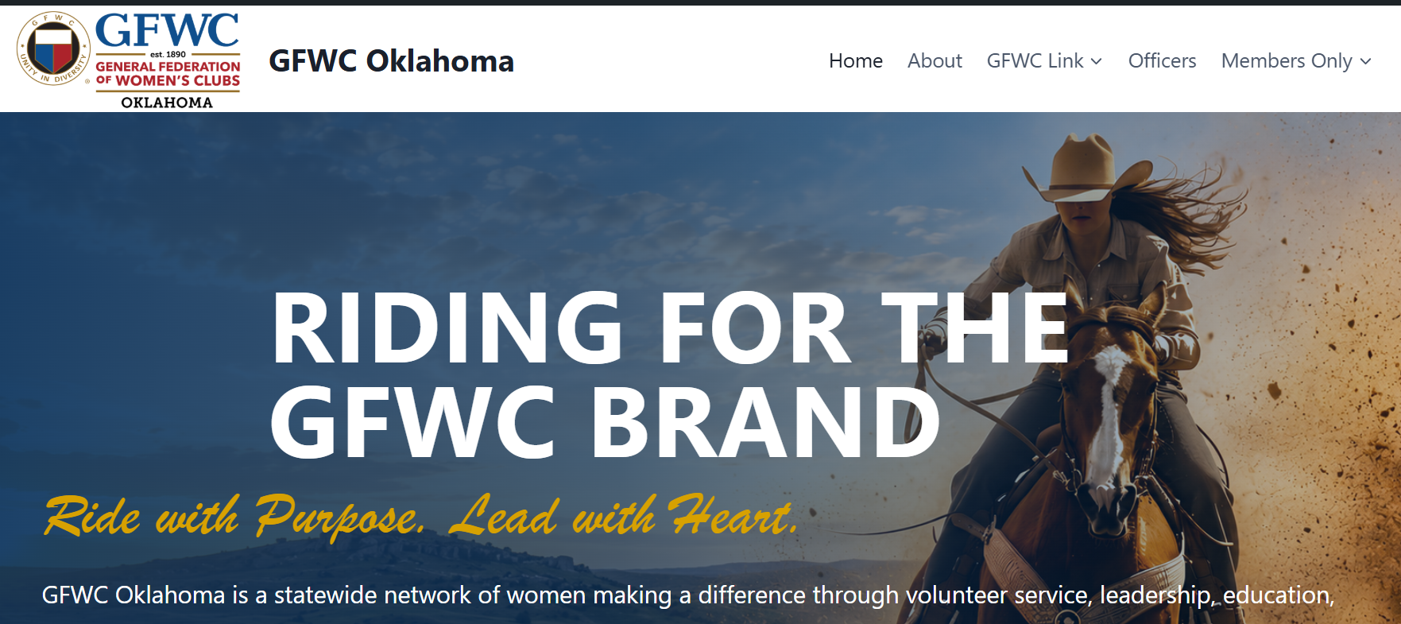
On your computer, phone or iPad select your browser and type in www.gfwc-ok.org.
To access the 2026-2028 Yearbook, Report Forms, or Newsletters select Members Only (circled above).

Slide 5
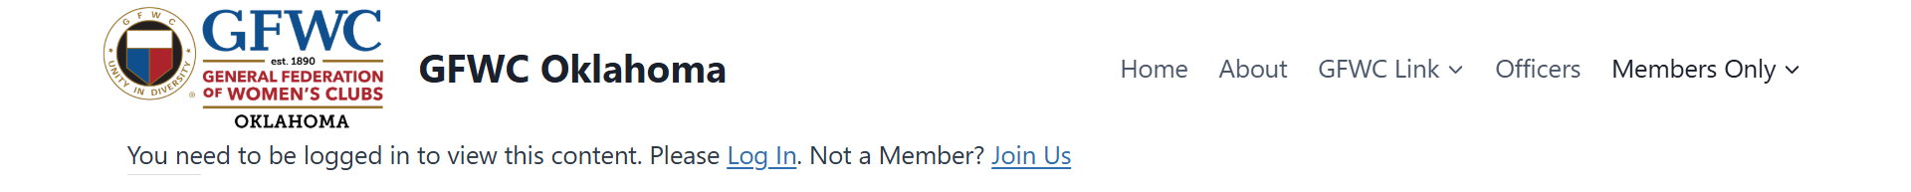
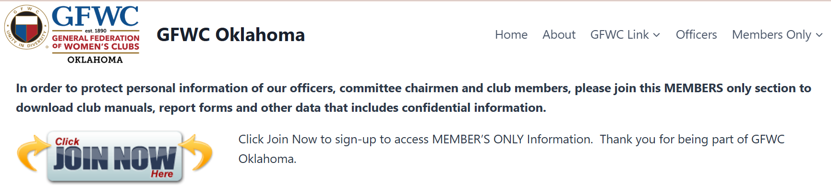
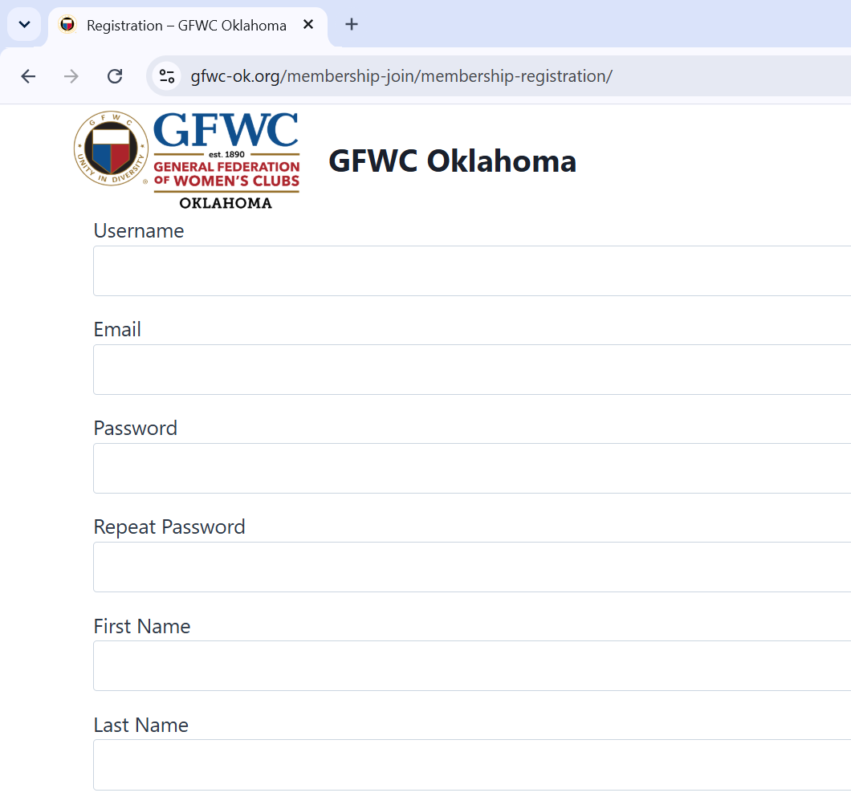
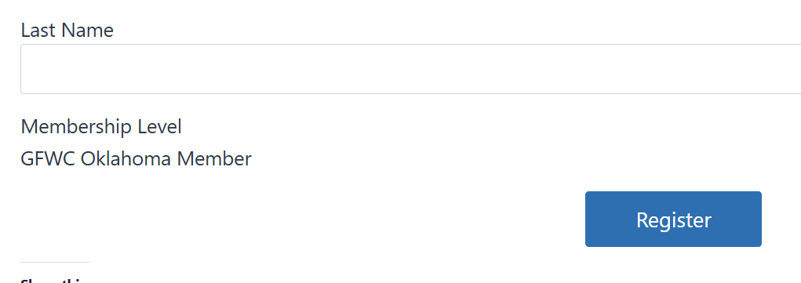
If this is your first time to access the Members Only Section, select Join Us Click on JOIN NOW
  Fill in the information on the Join Us Screen
  You will be sent an email that confirms your
  information links to a working email account.
  The email will send you back to the
  Log-In Screen.
  Log in using the credentials you created.
Link to the website

Slide 6
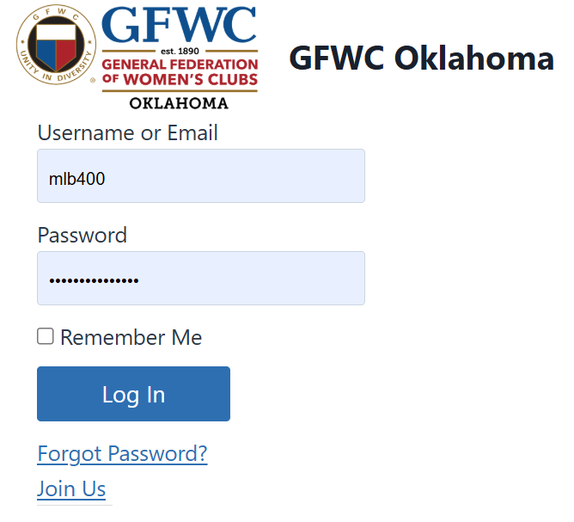
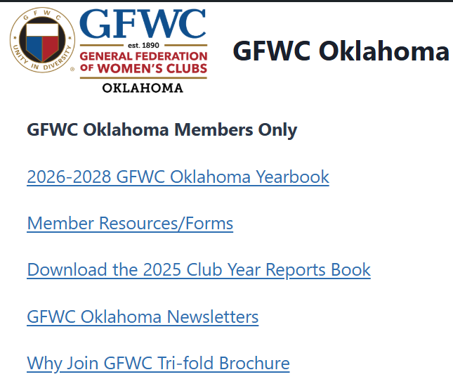
If you are returning to the site, select Log-In
  From the log-in screen, enter your credentials
  If you clicked the box to save your information,
    when you select Members Only from the top tab,
    you will be directed to the information on the
    Member’s Only Page.
Link to the website

Slide 7

Minutes, Not a Memoir
How to record what matters — without writing War and Peace
GFWC Oklahoma • Practical Parliamentary Skills
The secretary records the meeting — not every breath taken during it.

Slide 8
The Golden Rule of Minutes
Minutes are a record of what was DONE — not everything that was SAID.
• Capture decisions, actions, motions, elections, reports and assignments.
• Summarize only what is necessary to understand the official action.
• Leave out play-by-play debate, personal opinions and colorful side conversations.
GFWC Oklahoma • Riding for the GFWC Brand | 2

Slide 9
What Belongs in the Minutes?
• Organization name, date, time and place of the meeting.
• Whether the president/chair and secretary were present; who presided.
• Approval or correction of the previous minutes.
• Reports that were received — especially recommendations that lead to action.
• Every main motion and its final disposition.
• Elections, appointments, assignments, deadlines and adjournment time.
Think: Could a member who missed the meeting understand what the club officially did?
GFWC Oklahoma • Riding for the GFWC Brand | 3

Slide 10
What Does NOT Belong?
• “Mary gave a wonderful report.” Wonderful is an opinion.
• A transcript of who said what during debate.
• Jokes, gossip, facial expressions, sighs, eye rolls or who was texting.
• Your editorial comments: “After a painfully long discussion…”
• Every detail from a written report that can simply be filed with the secretary.
If the minutes start sounding like a reality show recap, edit.
GFWC Oklahoma • Riding for the GFWC Brand | 4

Slide 11
Motions: The Part You Really Need to Get Right
• Record the exact wording of the main motion — or as close to exact as possible.
• Record the name of the member who made the motion.
• Do NOT normally record who seconded the motion.
• Record whether the motion was adopted, lost, postponed, referred, withdrawn, etc.
• Include amendments when they affect the final wording or outcome.
• For counted votes, record the count; for ballot votes, record the result.
GFWC Oklahoma • Riding for the GFWC Brand | 5

Slide 12
Motion Example: Too Much vs. Just Right
TOO MUCH
Jane said we really ought to buy new tablecloths because the old ones look terrible. Susan agreed. Linda thought red would be prettier. After several members discussed stains, storage and whether round tables are coming back, Jane moved…
JUST RIGHT
Jane Smith moved that the club purchase six red tablecloths at a cost not to exceed $150. The motion was adopted.
GFWC Oklahoma • Riding for the GFWC Brand | 6

Slide 13
Discussion: Record the Outcome, Not the Argument
• Debate belongs to the meeting; decisions belong in the minutes.
• If background is essential, use one neutral sentence.
• Avoid attaching comments to individual members unless the organization specifically requires it.
• Never use minutes to settle scores. Future generations do not need to know who was ‘a little snippy.’
Minutes should be boring in the very best possible way.
GFWC Oklahoma • Riding for the GFWC Brand | 7

Slide 14
Reports: Don't Re-Type the Treasurer's Life Story
• Treasurer: record key balances or the fact that the report was presented, according to club practice.
• Committee chair: record recommendations and any action taken.
• Officer report: record significant official information, deadlines or assignments.
• Written reports may be filed or attached when appropriate — the minutes can say the report was presented.
A report is not a motion. ‘I move that my report be accepted’ is usually unnecessary.
GFWC Oklahoma • Riding for the GFWC Brand | 8

Slide 15
A Simple Formula for Every Agenda Item
1. WHAT?
What item came before the club?
2. ACTION?
Was there a motion, election, assignment or decision?
3. RESULT?
Adopted? Lost? Referred? Deadline set?
4. NEXT?
Who is responsible and what happens next?
If you can answer these four questions, you probably have enough for the minutes.
GFWC Oklahoma • Riding for the GFWC Brand | 9

Slide 16
Secretary Survival Tips
• Use the agenda as your note-taking outline.
• Ask the maker of a complicated motion to provide it in writing.
• Mark ACTION, MOTION and DEADLINE in your notes so they are easy to find later.
• Draft the minutes soon after the meeting — while your notes still make sense.
• Proof names, dollar amounts, dates and motion wording.
• Keep approved minutes and supporting records according to your club's retention practices.
GFWC Oklahoma • Riding for the GFWC Brand | 10

Slide 17
The Secretary's Red-Pen Test
• Is it a fact?
• Is it official business?
• Does it document an action, decision or responsibility?
• Would the organization need this information later?
• Could I remove this sentence without changing the official record?
If the answer to the last question is YES… your delete key has volunteered for service.
GFWC Oklahoma • Riding for the GFWC Brand | 11

Slide 18
Remember:
Record what happened.
Record what was decided.
Record what happens next.
And please — do not record who ate the last cookie unless a motion was involved.
GFWC Oklahoma • Ride with Purpose. Lead with Heart.

Slide 19

Report Writing that tells a story:
A report should be long enough to tell what happened, and short enough that the reader still remembers the beginning.

Slide 20

GFWC Reporting
1

Slide 21
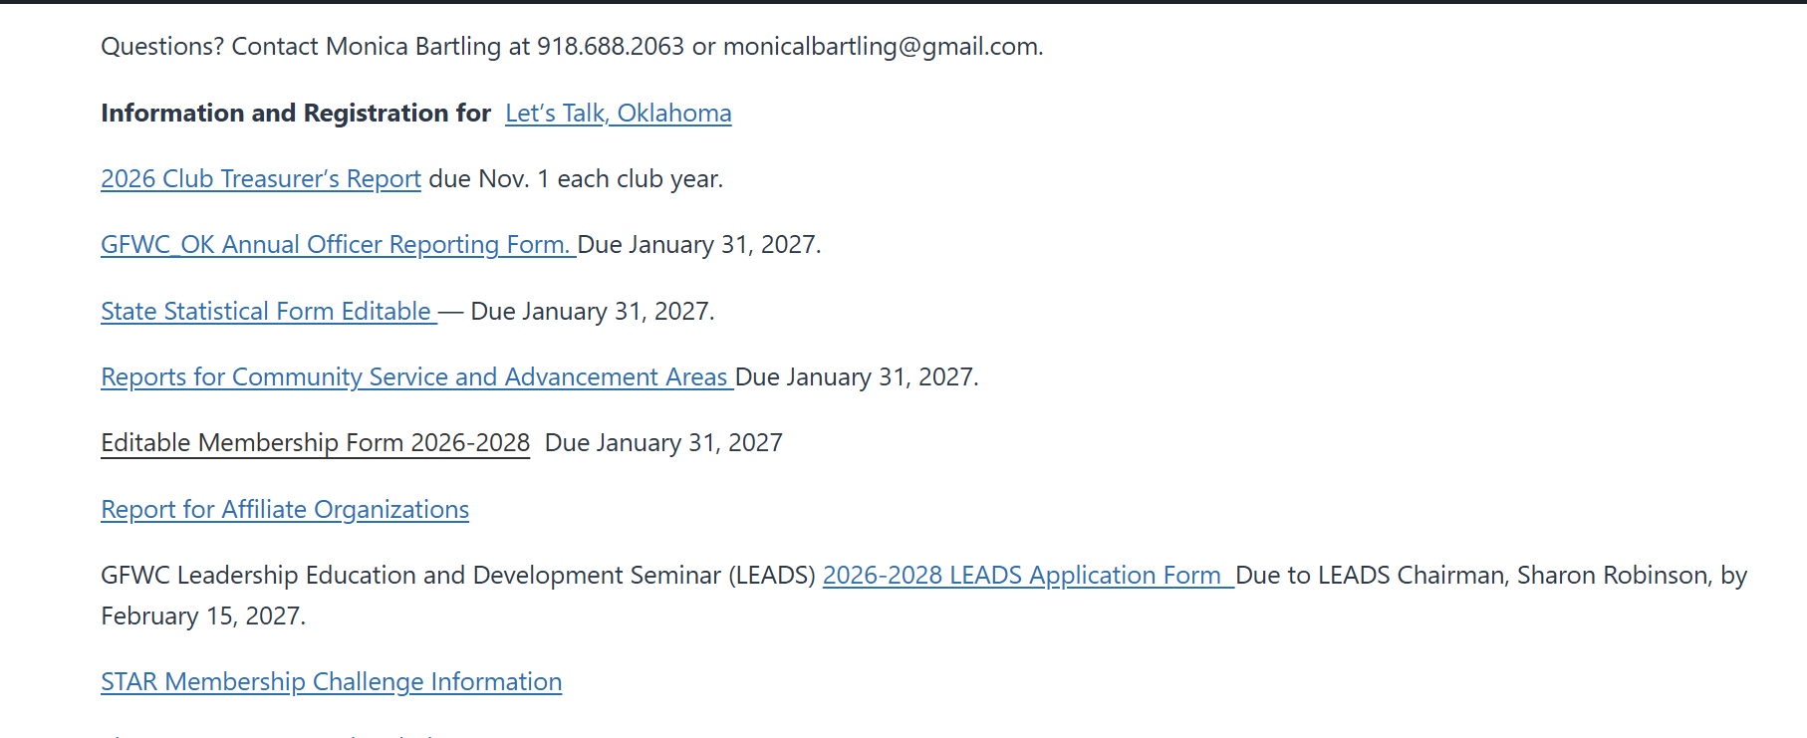
GFWC Reporting
Make sure to download forms to your computer
and save them before you input data into the forms.
1

Slide 22
Reporting Frequently Asked Questions.
Why do I report the numbers on the statistical form and also
on the Narrative Reports and should those numbers match?
The Statistical Form tracks everything your club does in a subject area.
The Narrative Report tracks specific projects and the numbers for those projects.
Example: You club hosted a speaker on the environment. It was informative, but no action was taken, no donations made. You would include that in the statistics report, but you might not report that event on your narrative. However, Let’s say you had a speaker from Keep Oklahoma Beautiful and from that event your club organized a Community Clean Up event with KOB, your local Rotary Club, your Main Street Group and Municipality. You would count all the volunteers including the meetings with the other groups AND report on the event on your narrative form. Your event Chairman should keep track of volunteer hours, dollars spent, dollars made for the narrative report.
Don’t make reporting so labor intensive that it keeps people from enjoying their volunteer commitments.
1

Slide 23
Reporting Frequently Asked Questions.
Where d?
What about non GFWC work that our members do in the community.
Leadership reporting is where you keep track of community involvement that is not part of your club events. If you have members who are officers in various other local groups and have events associated with those groups. You would report those hours, dollars donated (personal not club donations) under leadership. GFWC membership should train our members to lead other organizations.
1

Slide 24
Now, let’s talk about some tips on report writing.

Slide 25
GFWC Report Writing: Tell the Story, Count the Impact
Environmental Category • with a little frontier-style wit
A practical example using the entirely respectable—and entirely mythical—town of Sassafras Springs, Oklahoma.
Goal: turn several good projects into one clear, measurable, judge-friendly report of 1,000 words or less.
A report should be long enough to tell what happened, and short enough that the reader still remembers the beginning.
1

Slide 26
First Rule: Just like when you record the meeting minutes,
Focus on Results, Not Every Sandwich Served
Lead with the need: What environmental problem or opportunity did the club address?
Name the action: What did members actually do?
Identify partners: Who helped, donated, matched funds, supplied expertise, or provided a site?
Measure impact: members, volunteer hours, dollars, trees, pounds of seed, acres/space improved, students reached.
Close the loop: What changed because the club acted?
If the committee debated the color of the work gloves for 20 minutes, history can survive without it.
2

Slide 27
Project 1: Ten Trees and Some Very Optimistic Shovels
24 club members partnered with the City of Sassafras Springs to plant 10 trees in a public park.
Club contribution: $500.
Trees Across America matching support: $1,000.
Members contributed 96 volunteer hours for planning, site preparation, planting, mulching, watering coordination, and publicity.
Report the benefit: shade, habitat, beautification, stormwater benefits, and a visible long-term community investment.
Never merely say, “We planted trees.” Ten trees, $1,500 invested, 24 members, and 96 hours tells a much taller tale.
4

Slide 28
Project 2: Trash-Off—Where Everybody Wins Except the Litter
20 members organized a community Trash-Off with Keep Oklahoma Beautiful, the city, Persimmon County, and the school district.
The club contributed $200 for youth and community cleanup prizes.
Members logged 82 volunteer hours organizing teams, recruiting participants, coordinating collection points, judging, and cleanup.
Useful impact measures to include when available: participants, bags collected, pounds/tons removed, miles or acres cleaned, and number of youth involved.
“We picked up trash” is an activity. “Five partners mobilized the community” is a report.
5

Slide 29
Project 3: Wildflowers in December—Because Seeds Know What They’re Doing
16 members worked with Sassafras Springs Parks and the Oklahoma Native Plant Society on a December native wildflower planting.
ONPS donated 2 pounds of native wildflower seed.
Members contributed 54 volunteer hours for planning, site preparation, sowing, signage, and community education.
Explain why December mattered: dormant seeding allows natural winter conditions to prepare many native species for spring germination.
Good reporting explains the “why.” Otherwise December seed-sowing can sound like gardening by people who misplaced the calendar.
6

Slide 30
Project 4: A Pollinator Garden That Teaches While It Blooms
18 club members partnered with Sassafras Springs Public Schools to plan and plant an educational pollinator garden.
Members and students selected native plants supporting bees, butterflies, and other pollinators.
Members contributed 68 volunteer hours for design, plant selection, preparation, planting, educational materials, and student activities.
Report both environmental and educational impact: habitat created + students learning why native plants and pollinators matter.
7

Slide 31
Now Do the Math Before the Judges Have To
Volunteer hours: 96 + 82 + 54 + 68 = 300 hours
Club funds contributed: $500 + $200 = $700
Outside monetary support: $1,000 matching grant
In-kind donation: 2 pounds of native wildflower seed (record fair-market value if known)
Total documented cash invested in projects: $1,700
Do not add member counts across projects and call them “78 members” if many were the same people. Report participation by project or use unique-member totals.
Numbers are shy creatures. If you do not put them in the report, the reader will not go hunting for them.
8

Slide 32
A Simple Formula for Every Project Paragraph
NEED — What problem, opportunity, or community goal prompted the project?
ACTION — What did the club plan, organize, contribute, plant, clean, teach, or advocate?
PARTNERS — Who expanded the club’s reach?
NUMBERS — Members, hours, money, donations, participants, items, acreage, trees, pounds, students.
IMPACT — What is better now, and what may continue after the reporting year?
Need + Action + Partners + Numbers + Impact. That is considerably more useful than “A good time was had by all.”
9

Slide 33
Sample Finished Environmental Report
Approximately 650 words—comfortably below the 1,000-word ceiling
The Sassafras Springs Progress Club made environmental stewardship visible, practical, and educational through four community partnerships. During the reporting year, 16–24 members participated in projects addressing community beautification, litter prevention, native habitat, pollinator support, and youth education. Members contributed 300 volunteer hours and $700 in club funds. Partnerships generated an additional $1,000 in matching support, bringing documented cash invested in environmental projects to $1,700, plus an in-kind donation of two pounds of native wildflower seed.
COMMUNITY TREE PLANTING. Twenty-four members partnered with the City of Sassafras Springs to plant 10 trees in a public park. The club invested $500, which was matched with $1,000 from Trees Across America. Members contributed 96 volunteer hours to planning, site preparation, planting, mulching, publicity, and arrangements for continued watering and care. The project created a long-term investment in shade, wildlife habitat, stormwater benefits, and community beautification while demonstrating how a local club can multiply its resources through partnership.
COMMUNITY TRASH-OFF. Twenty members organized a community cleanup with Keep Oklahoma Beautiful, the City of Sassafras Springs, Persimmon County, and Sassafras Springs Public Schools. The club contributed $200 toward prizes designed to encourage youth and community participation. Members provided 82 volunteer hours for organizing cleanup teams, recruiting participants, coordinating collection locations, publicity, judging, and cleanup. The partnership broadened participation beyond club membership and connected litter prevention with civic pride and youth involvement.
NATIVE WILDFLOWER PLANTING. Sixteen members joined Sassafras Springs Parks and the Oklahoma Native Plant Society for a December dormant-seeding project. ONPS donated two pounds of native wildflower seed and provided guidance on species selection and planting. Club members contributed 54 volunteer hours to planning, site preparation, sowing, signage, and public education. The planting will provide future nectar and habitat for pollinators while demonstrating the value of native plants in public landscapes. The December planting also provided an opportunity to explain how natural winter conditions help prepare many native seeds for spring germination.
EDUCATIONAL POLLINATOR GARDEN. Eighteen members worked with Sassafras Springs Public Schools to plan and plant an educational pollinator garden. Members and students selected native plants that support bees, butterflies, and other pollinators and discussed the relationship among native plants, insects, food systems, and healthy ecosystems. Members contributed 68 volunteer hours to garden design, plant selection, preparation, planting, educational materials, and student activities. The garden created both habitat and an outdoor learning space that can continue serving students in future years.
Together, these projects show the club’s environmental work as more than four separate activities. By combining member service, local government cooperation, nonprofit expertise, school participation, matching funds, and donated materials, the club turned $700 of its own funds and 300 volunteer hours into visible community improvements with lasting educational and environmental value.
10

Slide 34
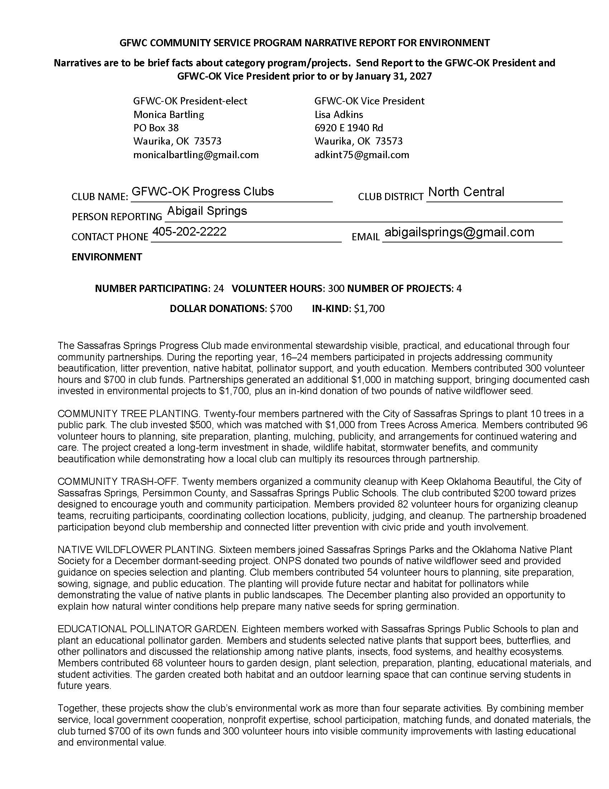
Creating the report
www.gfwc-ok.org
Members only section
Member Resources/Forms
Reports for Community Service and Advancement Areas
Page six is the form for GFWC Community Service Program for Environment.
11

Slide 35
Before You Hit Submit: The Frontier Checklist
Is the report under 1,000 words?
Did I count volunteer hours and club dollars?
Did I identify grants, matches, and in-kind donations separately?
Did I name meaningful partners?
Did I give specific quantities and outcomes?
Did I explain why the projects mattered?
Did I avoid minutes-style detail, repeated information, and unnecessary adjectives?
Could a judge understand the club’s impact without already knowing our town or our members?
Write so the reader can see the work, count the impact, and finish the report before the coffee gets cold.
11

Slide 36
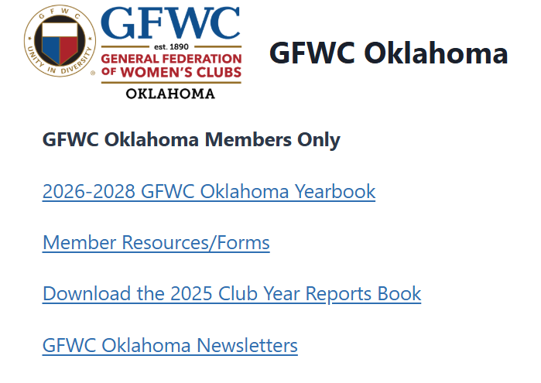
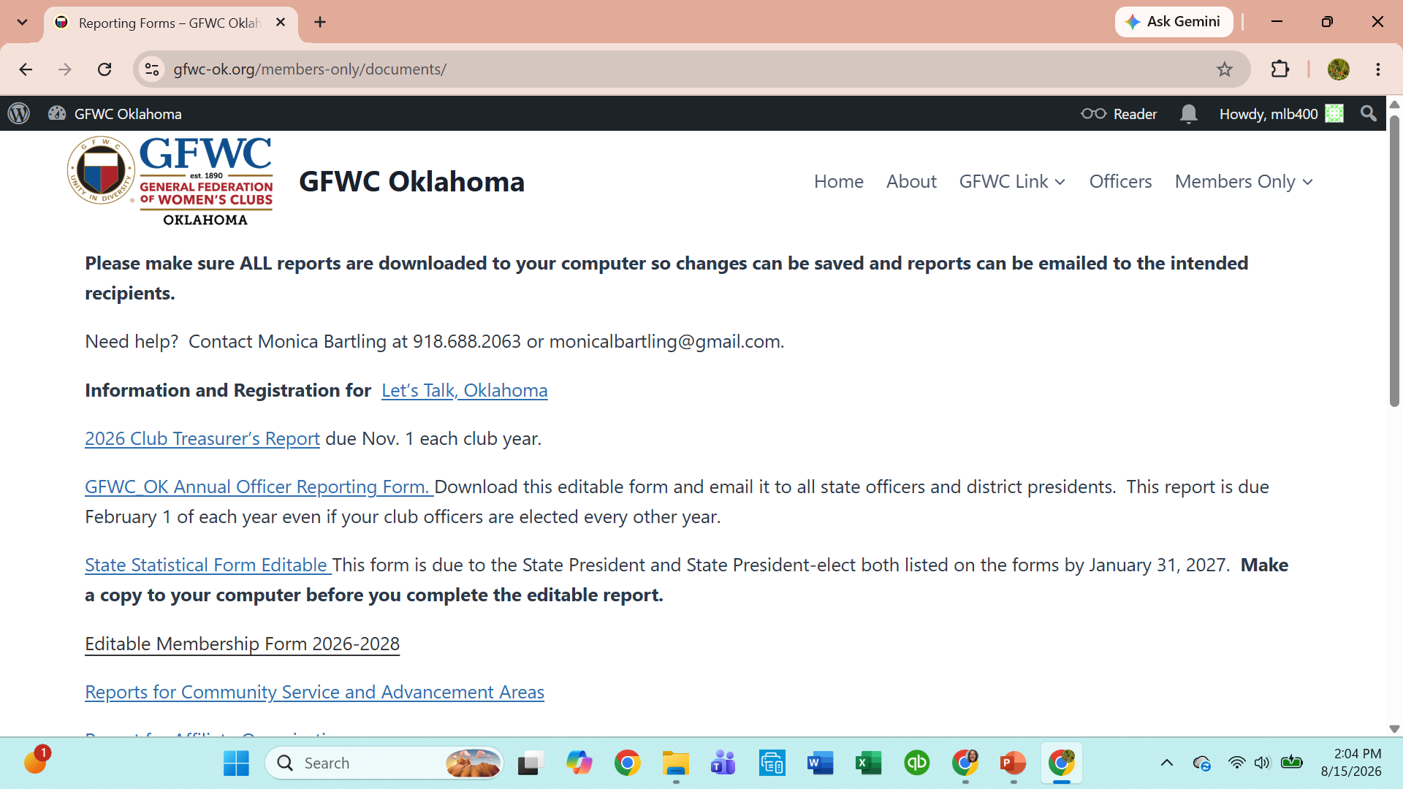
Treasurer’s Report
Go to Members Only
If you saved your credentials – they will auto populate so you can log in.
If you didn’t save your credentials, enter them in the user name and password box.
Select Members Only from the top tab bar, after you log in. That will take you to the list shown, at left.
From the list of options, select Member Resources/Forms
2026-2028 Treasurers Report.
From the list, at right, select 2026 Club Treasurer’s Report.
Use the down pointing error in the upper right corner of the screen (next to the printer icon), download the form to your desktop.
Fill in and save the report.
Club-Treasurers-report-1.pdf

Slide 37

New Documents available on the Website.
How to describe GFWC to potential new members.
Why Join GFWC Oklahoma (your club name):
Find Your People. Find Your Purpose. Make a Difference.
What if a few hours of your time could help a child discover a love of reading, support a woman rebuilding her life, beautify a community, honor a veteran, provide a scholarship, protect Oklahoma’s natural resources—or simply make someone’s day a little brighter?
That’s what GFWC women do.
GFWC Oklahoma brings together women of different ages, backgrounds, talents, and experiences who share something important: we want to make our communities better.
You don’t have to be an expert.
You don’t have to have unlimited free time.
And you definitely don’t have to do everything.
Just bring what you have to give. There’s a place for you here.

Slide 38
Make an Impact Close to Home
GFWC clubs decide how they can best serve their own communities.
That means the work is personal, practical, and local.
Our members support projects involving Arts & Culture, Civic Engagement & Outreach, Education & Libraries, Environment, Health & Wellness, Domestic Violence Awareness and Prevention and other important community needs.
Whether you’re planting wildflowers, collecting supplies for a domestic violence shelter, supporting a library, recognizing local heroes, helping families in need, encouraging civic involvement, or organizing a community event, you’ll see what happens when women turn good ideas into action.
Discover What You Can Do
GFWC isn’t only about what you give. It’s also about how you grow.
Membership provides opportunities to develop leadership skills, learn something new, use talents you already have, discover talents you didn’t know you had, and connect with women throughout Oklahoma and beyond.
You can lead a project—or show up and lend a hand.
Both matter.

Slide 39
Find Friendship Along the Way
Ask longtime clubwomen why they stay in GFWC and you’ll often hear about the friendships.
Working side by side has a way of turning acquaintances into friends. GFWC brings together women who might never have met otherwise and gives them a reason to laugh together, learn together, travel together, celebrate together—and occasionally discover just how many clubwomen it takes to decorate a banquet hall.
Service may bring us together. Friendship helps keep us together.
Be Part of Something Bigger
When you join a GFWC Oklahoma club, you’re not joining just one local organization.
You become part of the General Federation of Women’s Clubs, a network of clubwomen united by a long tradition of volunteer service and community leadership. The General Federation of Women’s Clubs includes more than 63,000 members in affiliated clubs in every state, the District of Columbia, and more than a dozen countries.
Your local project becomes part of a much bigger story—women working together to strengthen communities across Oklahoma, across the nation, and around the world.

Slide 40
There’s a Place for You at Our Table.
Maybe you’ve been looking for a meaningful way to give back.
Maybe you’d like to meet new people.
Maybe you have an idea that could make your community better and need a group of women willing to say, “Let’s do it.”
Or maybe you’re simply ready for something new.
Come sit with us.
Bring your ideas. Bring your talents. Bring your experience. Bring your sense of humor.
Together, we can do more than any one of us can do alone.
Ready to Get Started?
To find a club near you, visit our website at GFWC-OK.org/Find a Club and discover how you can start Living the Volunteer Spirit.

Slide 41
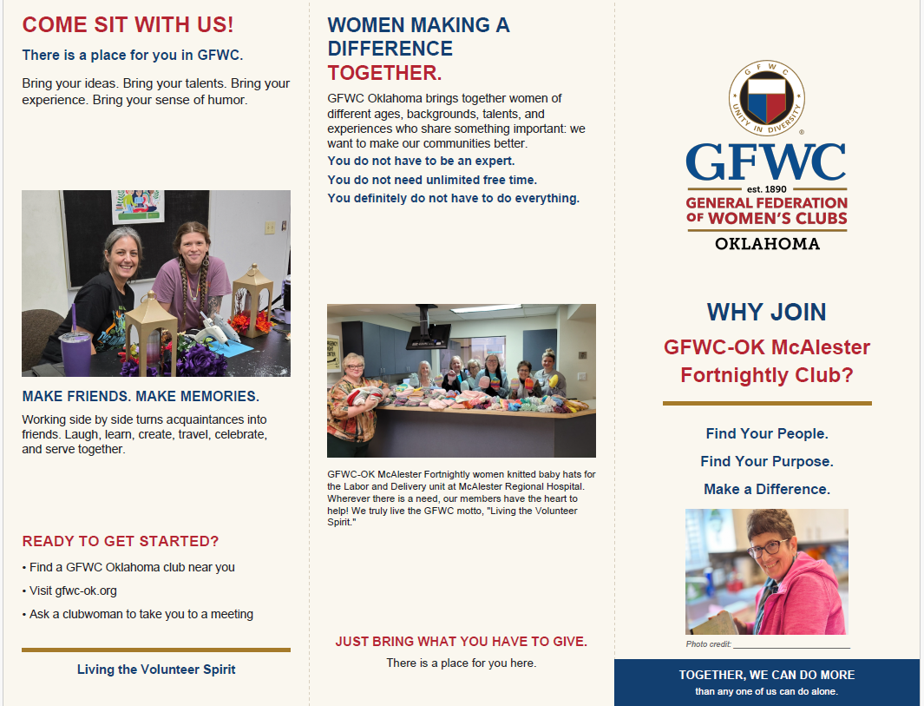
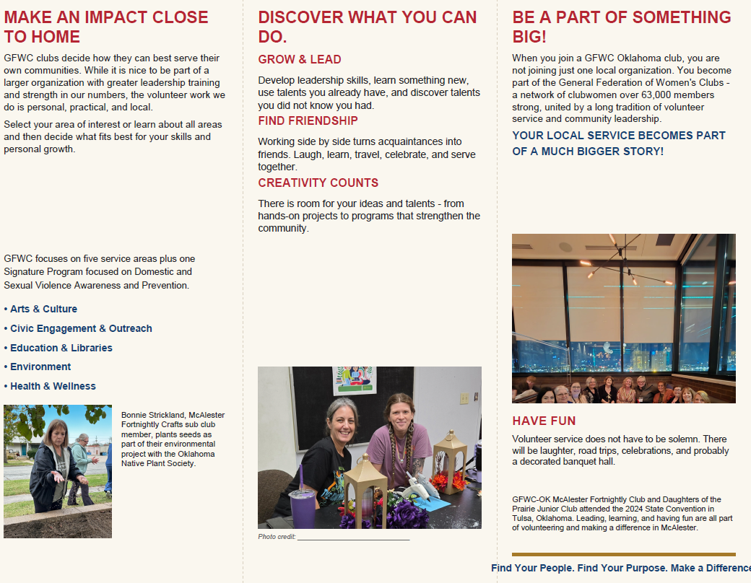
Download a brochure format.
Enter photos (spaces for four photos) of your club activities.
Download and update.

